Slide 1
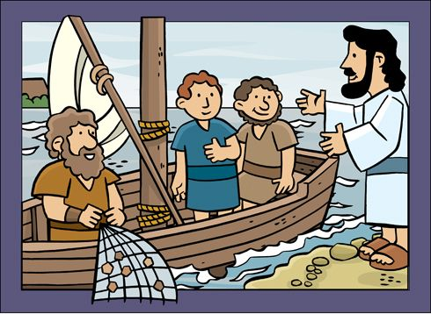
CHRIST’S CALL TO SOUL-WINNING
TEXT: LUKE 5:1-39

Slide 2

MEMORY VERSE
“And so was also James, and John, the sons of Zebedee, which were partners with Simon. And Jesus said unto Simon, Fear not; from henceforth thou shalt catch men.” Luke 5: 10

Slide 3
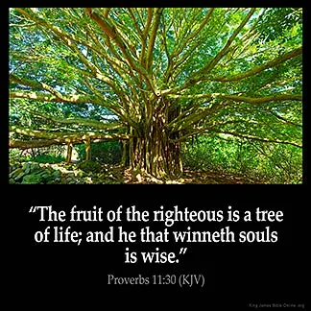
INTRODUCTION
Soul-winning means the preaching of the gospel with the aim of making sinners repent and accept Jesus as Lord and Saviour.
This is the most important assignment given to all believers.
Jesus Christ, our Saviour, used every means (method) available to win sinners because of the importance He attached to souls.
When He was on earth, He went about preaching the gospel and called people to repentance.

Slide 4
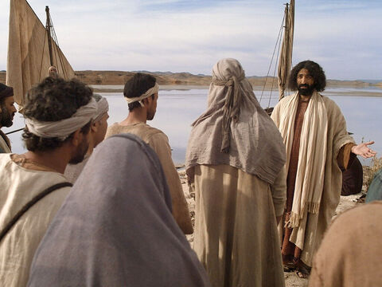
INTRODUCTION
In our Bible passage, Jesus called Peter, Andrew, James and John to follow Him. They obeyed.
At another time, He forgave a sinner and healed Him, showing that Jesus has concern for our soul and body as well and has the power to forgive sin.
He also called Levi(a publican), who immediately followed Him.
When one obeys the call of Christ, there is always a change of heart and lifestyle.
The sinner no longer remains the same; his devotion is now towards Christ.

Slide 5
INTRODUCTION CONT’D…
This was the message Jesus passed on to the Scribes and Pharisees, who were angry with Him because He went to the house of a sinner.
Before He left the world, He handed over this unfinished task to his disciples to continue (Matthew 28:19,20; Mark 16:15,16).
He expects His disciples today (born-again boys and girls) to do as He did while on earth.
If we fail Him, He will not be happy with us. But if we obey and do the work, He will be happy and bless us.

Slide 6

INTRODUCTION CONT’D….
This task is so important to Jesus because souls are dying every second, and many of them who do not know Him as their Lord and Saviour will spend eternity in hell-fire.
Jesus does not want anybody to go to hell-fire.
Do you want your friends to go to hell-fire?
That is why you must win them to Jesus.

Slide 7
OUR STUDY IS IN THREE PARTS:
1
WHO CAN WIN SOULS?
2
WHERE AND HOW TO WIN SOULS?
3
WONDERFUL BENEFITS FOR WINING SOULS

Slide 8
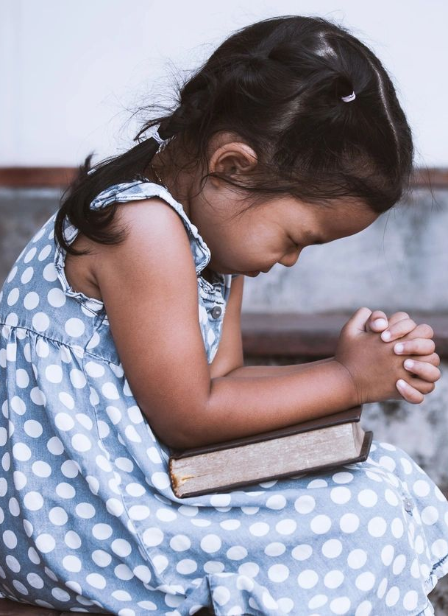
WHO CAN WIN SOULS? Luke 5:1-11, 27-32; John 3: 3-5.
A man was travelling from his village to another village. Along the way, he fell into a well with his co-travellers. The man was in the well and tried very hard to bring out other people in the same well. He could not because he was in the well himself.
Before Jesus commissioned His disciples to preach, He called them first to repent. Thereafter, they were qualified to preach the gospel.
If you are still doing bad things like fighting, stealing, cheating in examinations, and lying, you cannot win souls because you are like the man in the same well who could not save himself and others.
The work of soul-winning is for those who are saved.

Slide 9
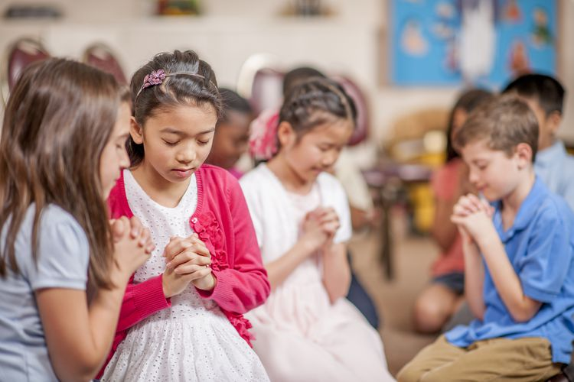
WHO CAN WIN SOULS CONT’D.
Before you can obey this command to win souls, you must first acknowledge yourself as a sinner who cannot save himself/herself.
Confess all your sins to God, ask Jesus to forgive you and wash you with His blood, and ask Him to come into your heart as your Lord and Saviour.
Now you can go out and win others.

Slide 10

2. WHERE AND HOW TO WIN SOULS? Luke 5:18-39; Matt. 28:19,20; 2 Tim. 4:1,2.
When Jesus was on earth, He travelled long distances to different towns and villages to preach the gospel in order to win souls.
Even His disciples travelled far and near to do the same but we thank God today we may not need to travel far before we can win souls.
In our neighbourhood, schools, hospitals, streets, markets, and orphanages, there are many souls waiting for us to reach out to them with the gospel.

Slide 11
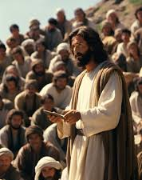
2. WHERE AND HOW TO WIN SOULS? CONT’D. Luke 5:18-39; Matt. 28:19,20; 2 Timothy 4:1,2.
Jesus personally spoke to individuals, groups of people and crowds at different times.
He forgave sinners, healed the sick and set the captives free.
He has given us the authority to do the same as we get involved in soul-winning work.

Slide 12

3. WHERE AND HOW TO WIN SOULS CONT’D.
Today, sinners can be reached in different ways; we can share tracts and give out Tender Life Magazines or other Christian Magazines and books.
We can also send short messages (SMS) and posts on Facebook and WhatsApp and pray for the salvation of sinners.
God will help us to win souls in all these ways.
Get involved, and you shall be blessed for doing that.

Slide 13
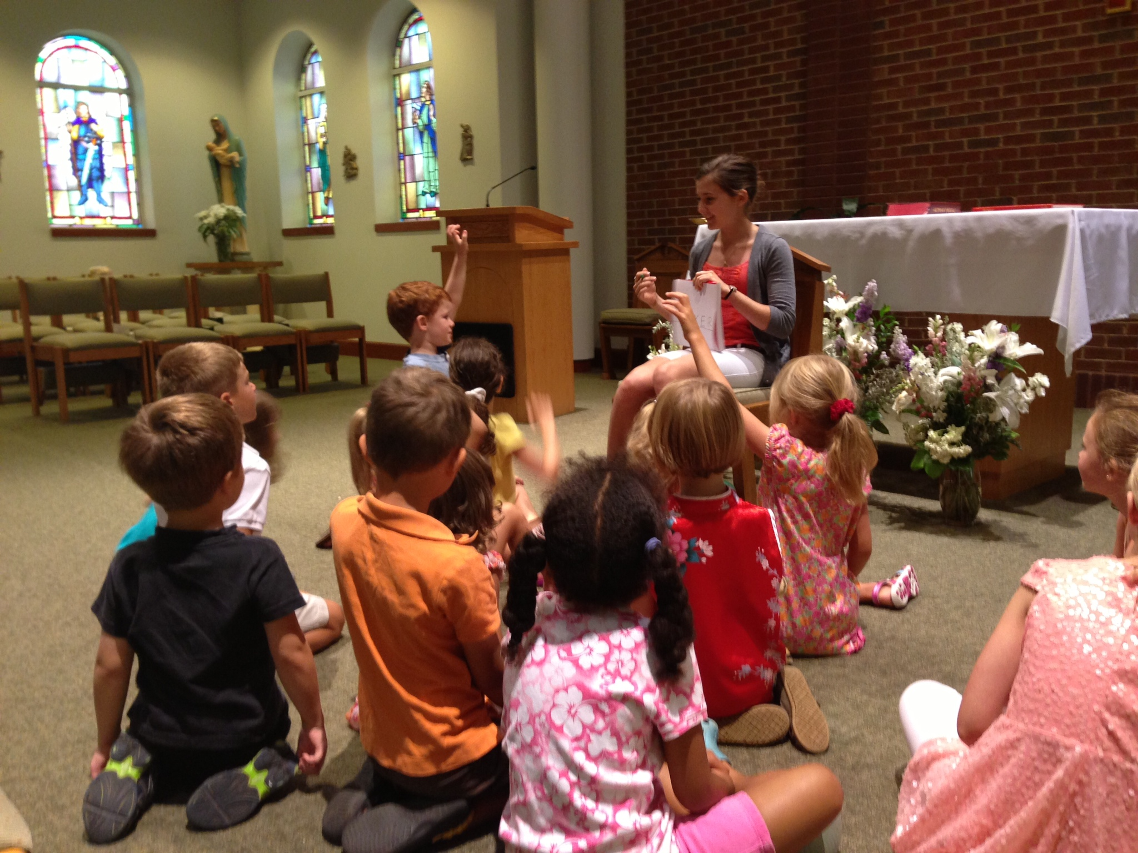
3. WONDERFUL BENEFITS FOR WINING SOULS: Luke 5:1-6; 15:10; Matthew 25:21; Daniel 12:3.
A songwriter wrote thus:
“Obedience brings a blessing (2x)
It always works, it never fails, I’ve found;
Just daring to step out upon the promises of Jesus;
Will always work; it never fails to bring the blessing down.”

Slide 14
3. WONDERFUL BENEFITS FOR WINING SOULS CONT’D.: Luke 5:1-6; 15:10; Matt. 25:21; Daniel 12:3.
Truly, obedience brings blessings. God will be happy with you as a soul-winner and shower a lot of blessings on you:
Many sinners will repent and be made fit for heaven;
There will be growth in the Church;
You will be happy that you have won souls.
God’s protection, provisions, success, good health, prosperity and many other blessings shall be your portion.
At last, you will have many stars in your crown when you get to heaven. Arise now and enlist in the army of soul-winners.

Slide 15

QUESTIONS:
Why is soul-winning a very important task?
Who commands the friends of Jesus to win souls?
Can sinful boys and girls win souls? Yes/No
Mention five methods we can use to win souls.
Mention three benefits of obeying Christ’s call to win souls.
Are you a soul-winner?

Slide 16


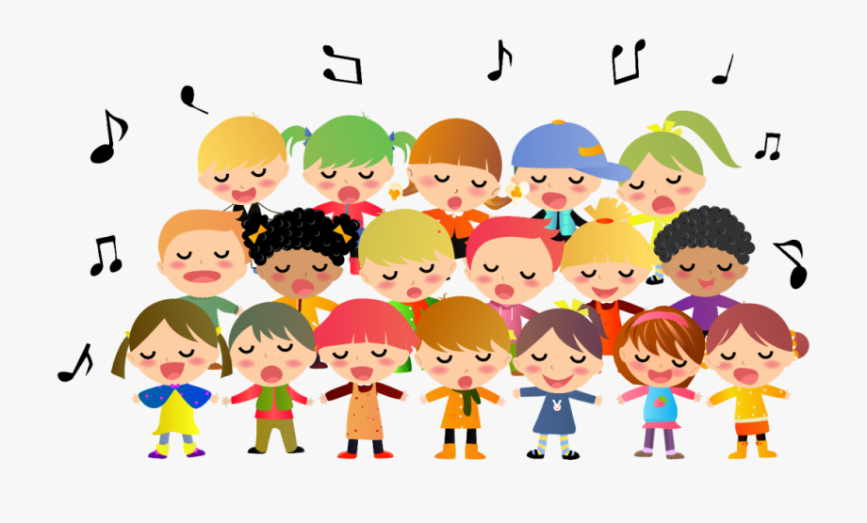
LESSONS, THOUGHT, GHS & CHORUSES.
LESSON: Friends of Jesus are called to win souls.
THOUGHT: I will win souls for Christ.
CONGREGATIONAL SONGS: GHS 107 – GO AND TELL THEM.
CHORUSES:
I will go o o, (2x) I will go and tell them Jesus is alive!
Go and tell them (2x) Jesus died for sinful men…
Isaiah heard the voice of the Lord…..

Slide 17
REFERENCES:
https://bummyla.wordpress.com/2017/04/23/soul-winning-an-unusual-strategy/
https://i.pinimg.com/736x/8f/3f/47/8f3f470660f9b4f877f91a7a18964b6b--image-of-jesus-jesus-calling.jpg
https://th.bing.com/th/id/OIP.Zt23WtxEpTqf1Yne2gZ0hgHaHa?rs=1&pid=ImgDetMain
https://th.bing.com/th/id/OIP.8DLDb2FBCpf_URz_64aCvAHaFo?rs=1&pid=ImgDetMain
https://i.ytimg.com/vi/kt3_zy4BmVo/maxresdefault.jpg
https://th.bing.com/th/id/R.d080758a296665a8db685855406cfb4b?rik=OPpuJJxUXrsssA&pid=ImgRaw&r=0
https://th.bing.com/th/id/OIP._8xX3DrqH3tF74IP4EekpwHaE8?rs=1&pid=ImgDetMain
https://www.learnreligions.com/thmb/OkuI3G-ENfF3n1fOJI5OWVvn_KM=/750x0/filters:no_upscale():max_bytes(150000):strip_icc()/Prayer-Activities-for-Kids-504328300-585419773df78ce2c3b05c3c.jpg
ttps://www.shutterstock.com/shutterstock/photos/68394601/display_1500/stock-vector-illustration-of-kids-having-a-bible-study-68394601.jpg
https://img.freepik.com/premium-vector/boy-give-book-friend_904112-32.jpg?w=360
https://th.bing.com/th/id/OIP.6kqXaWLghjU6xRfN77tjKQHaFj?rs=1&pid=ImgDetMain
https://th.bing.com/th/id/R.75ba70639dd867a26b1d20ab19613c48?rik=0bWWTWq6TsHEbg&pid=ImgRaw&r=0
https://th.bing.com/th/id/OIP.Kbhnuye26drFdZqPex5_4AHaEK?rs=1&pid=ImgDetMain
https://th.bing.com/th/id/OIP.8u9Gz57GHdEwXo6AWdzwRgHaEe?rs=1&pid=ImgDetMain

